Slide 1

Enhanced Deep Residual Networks for Single Image Super-Resolution
Bee Lim, Sanghyun Son, Heewon Kim Seungjun, Nah Kyoung & Mu Lee
Presented by: Eric Cañas
Notes:
Hi, my name is Eric and I will present Enhanced Deep Residual Networks for Single Image Super-Resolution. A paper which not only set the Super-Resolution State of the Art on Twenty Seventeen, but also had high influence on the later State of the Art.

Slide 2


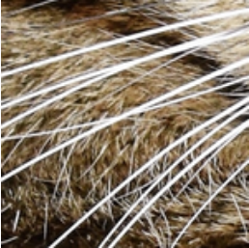

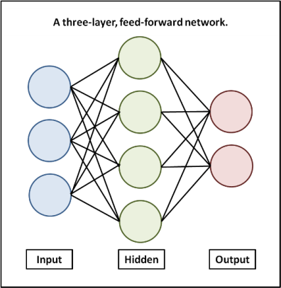
The problem of Super-Resolution
To hallucinate the new pixels
Notes:
Before presenting the Deep Learning Architecture that they proposed, lets first explain what Super-Resolution is. -> When we have an initial Image, with an arbitrary size, it is usual the case where we want -> to zoom on a concrete part -> But by the lack of pixels we obtain a really poor visualization. By this reason, what Super-Resolution aims is -> to hallucinate those new pixels, in Deep Learning case -> through a Deep Neural Network in order to obtain a -> high resolution sub-patch of the image. Which uses to be called, the super-resolved image.

Slide 3

The Architecture
Notes:
So lets present which is the architecture they proposed and why is it relevant.

Slide 4
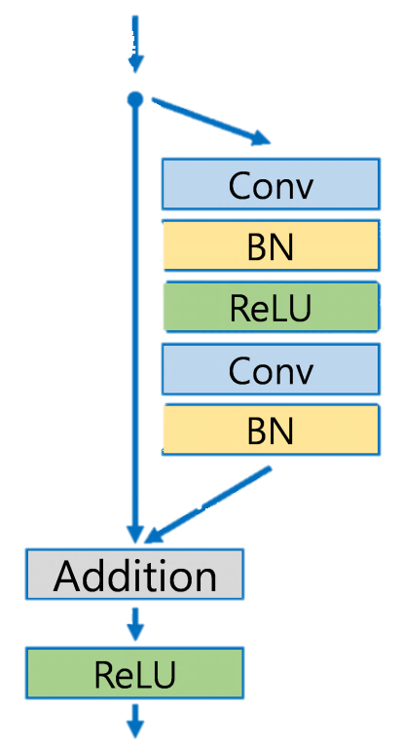
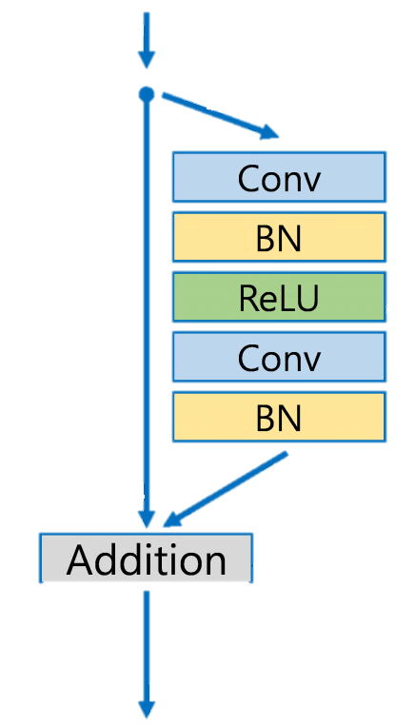
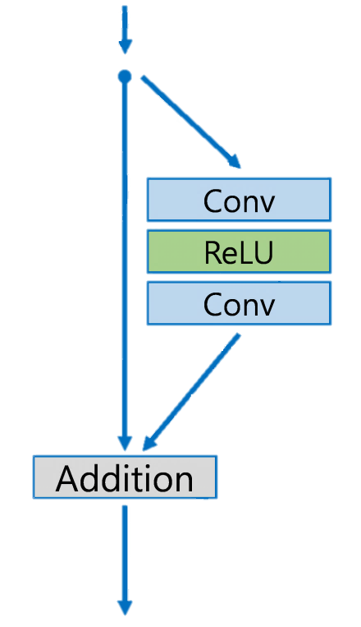
Enhancing Deep Residual Networks
for Single Image Super-Resolution
Original Residual Block
Super-Resolution Residual Block
New Proposed Residual Block
Notes:
The kind of Networks which are usually used for super-resolutions are the known as Deep Residual Networks (ResNets). These Networks are composed by -> the following original blocks. However, in super resolution is extremely common to delete -> this output ReLu activation -> In order to allow more flexibility. Now, the most important novelty that this work introduced, and the one which is still used in the current architectures at Twenty Twenty -> was to delete these Batch Normalization layers. -> Generating a simpler residual Block.

Slide 5

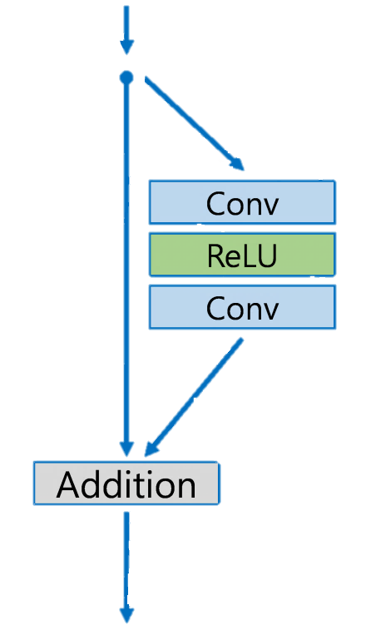


Reasons to delete BN Layers
Why they are counterproductive?
By normalizing features they get rid of the range flexibility
They supposed up to 40% of the GPU memory usage
Original Residual Block
New Proposed Residual Block
Notes:
They proposed two main reasons because deleting the Batch Normalization layers was a good idea in spite of being counterintuitive. -> The most important one was that this Batch Normalization Layers gets rid of the range flexibility of the network. Since by normalizing the features, the absolute information of each point intensities is lost. The second consequence of deleting these layers -> is that we can generate bigger batches, since the memory usage of the GPU is reduced up to a Forty per cent.

Slide 6
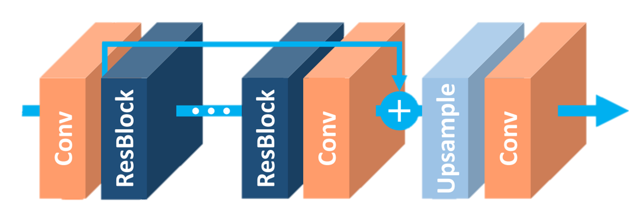
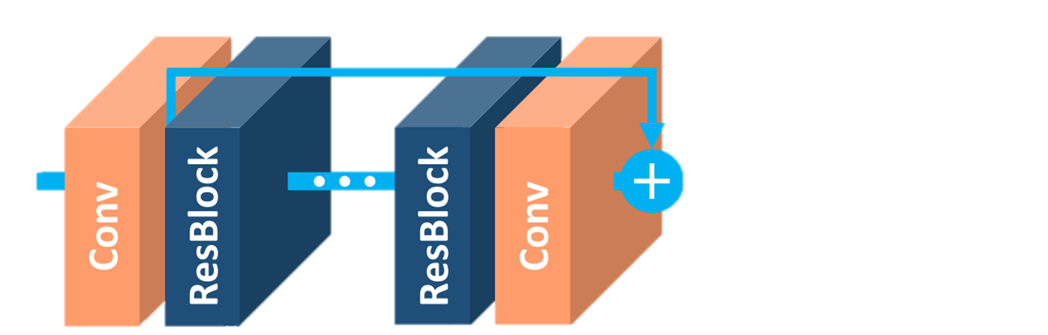

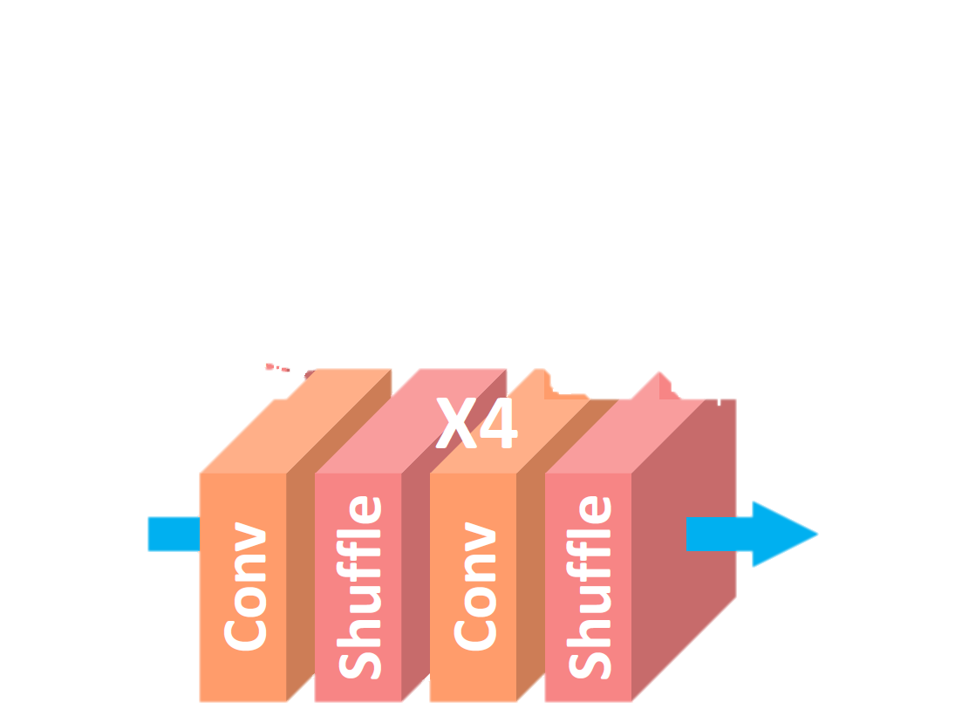
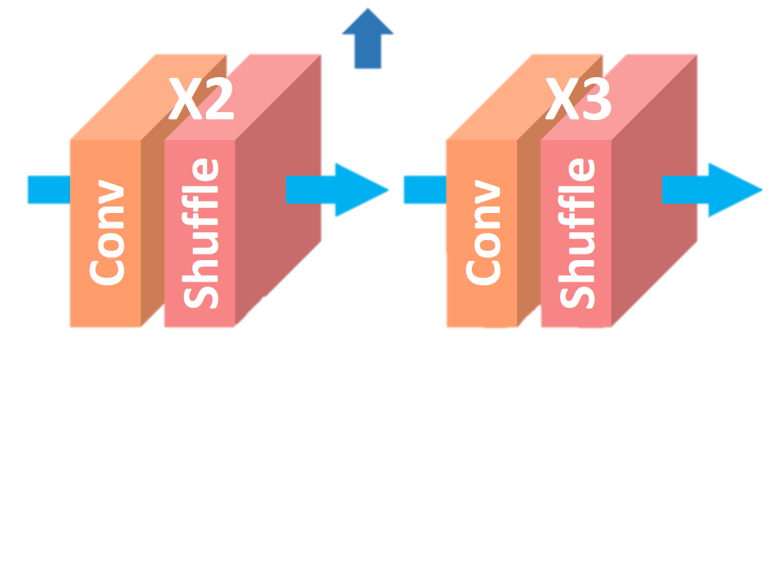
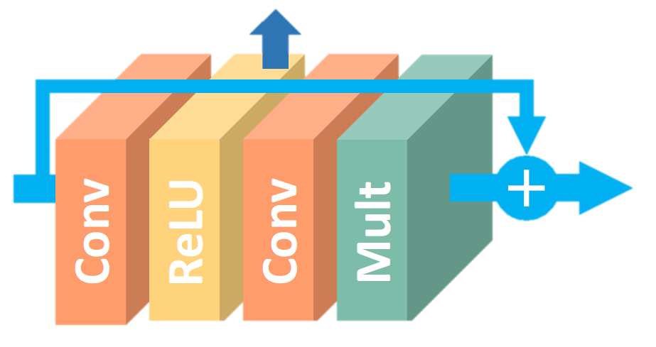
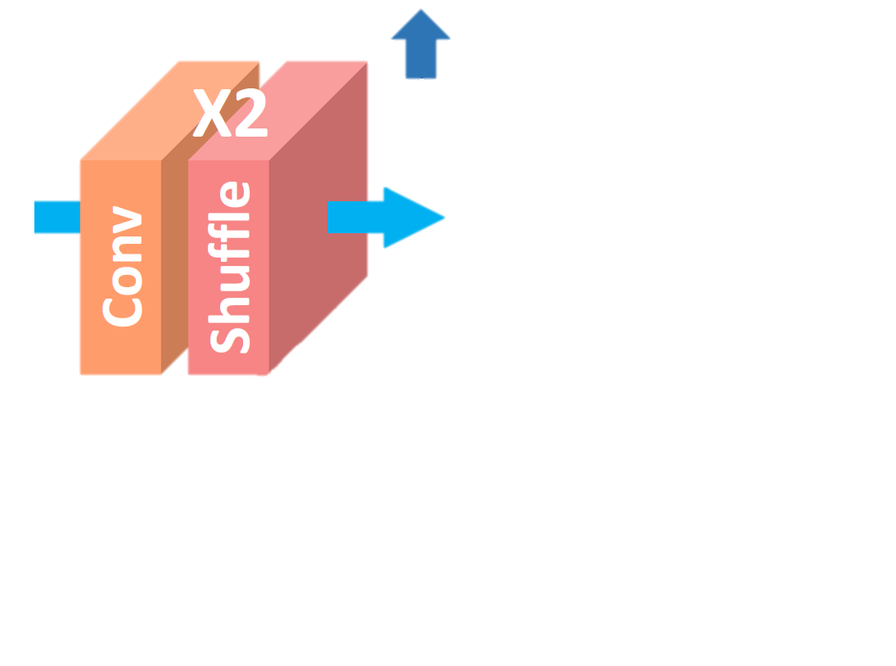
Single-Scale EDSR
The architecture proposal
x4
x3
x2
x*0.1
Notes:
So then, lets see which is the architecture of the network. -> It starts by an input Convolution, in order to transform the image to the amount of channels desired. -> Then they include a sequence of N Residual Blocks, followed by a convolution. Where each Residual Block -> is the one which we have seen at last slide, but adding a -> multiplication layer, which aims to minimize the modifications that each individual layer includes. Finally, -> they set an Upsample Block for increase the size of the image -> by two, -> by three -> or by four, which are composed by a convolution and a shuffle layer. This composition is usually known as sub-pixel convolution.

Slide 7

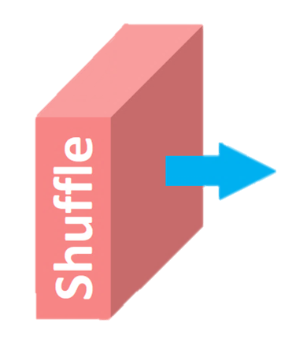
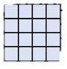
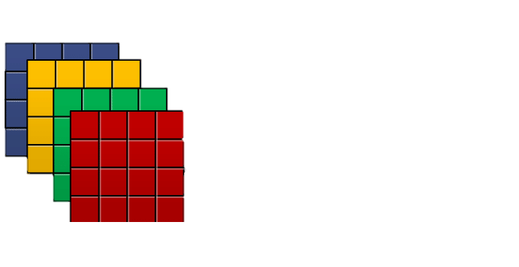
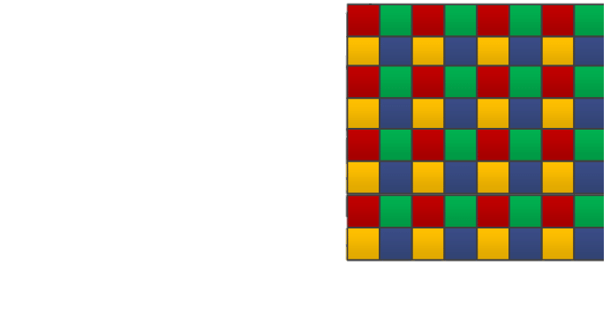

Sub-Pixel Convolution
The architecture proposal
4x4x1
4x4x(1$r^{2})$
4rx4rx1
Notes:
What these sub-pixel convolution do, is to -> take the input feature map ->and convolving it -> Generating r-square more channels (For example, in this case where we want to Upsample by a factor two, four times more channels). And then -> Redistributing those channels in the height and width space.

Slide 8
The Training
Notes:
Then, being this clear. Let’s present how they trained their network.

Slide 9
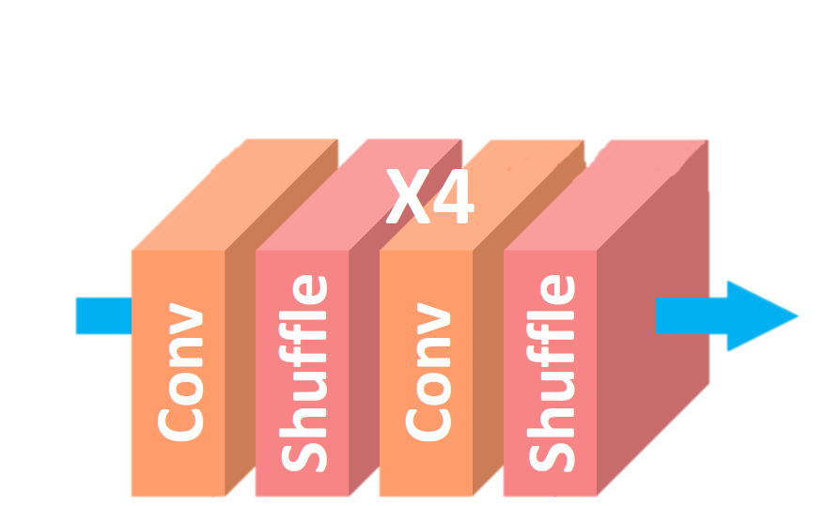

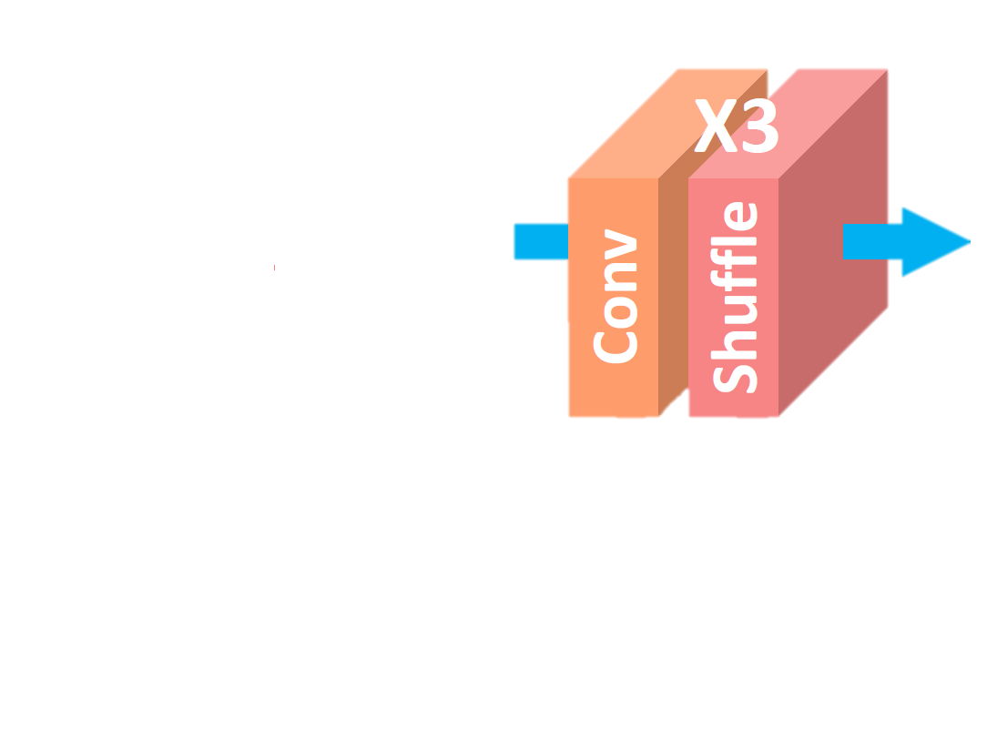




How they learn?
Curricular Learning
Notes:
As the problem of different factors upscaling is an incremental problem, they proposed to learn in a curricular way. -> That is, to first start by the easier problem, -> which is the lower factor. And then, when this problem is solved, to increment the difficulty -> upsampling by factor three, and finally -> by factor four. Using always the last network as pretrain.

Slide 10
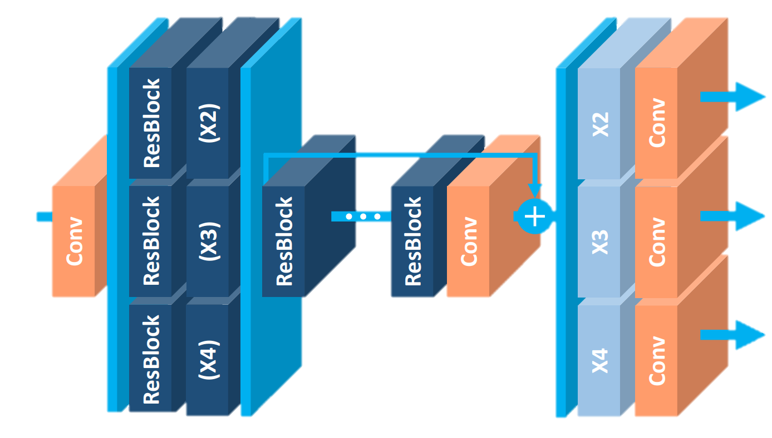
A parallel proposal
Multiscale MDSR
Worse results
Notes:
Additionally, -> they also proposed an architecture for training the three problems in parallel -> Generating the three outputs at same time. However, this approach gave -> worse results.

Slide 11


Improving the Training: Geometric Self-Ensemble
EDSR+ and MSDR+
2
(
)
-
Inverse Transform
& Average
Notes:
Finally, they also proposed to train in a geometric self-ensemble way. An approach that takes profit of the Geometric Data Augmentation for regularizing better. It works as follows: -> Usually when we have an image -> we use to apply its 4 rotations as data-augmentation -> And in top of that its 4 flips. What this method propose is, instead of taking one of these transformations at random, -> Generate a batch with all of them -> And pass this complete batch through the network -> For obtaining the prediction of all these versions of the same picture. Once they have been predicted, it applies -> the inverse transformation to each image, and average them. This averaged image -> is the one that must be compared with the ground truth, in order to compute the loss (The common Mean Square Error in this case). This approach has demonstrated to slightly improve the results in all tests performed.

Slide 12
The Results
Notes:
So, once the complete design and training processes have been explained. Lets present which were the results obtained.

Slide 13
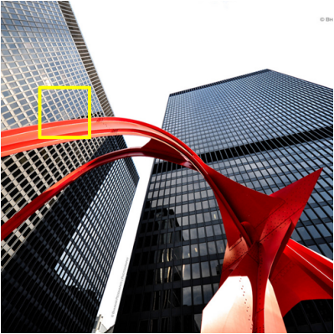
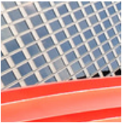
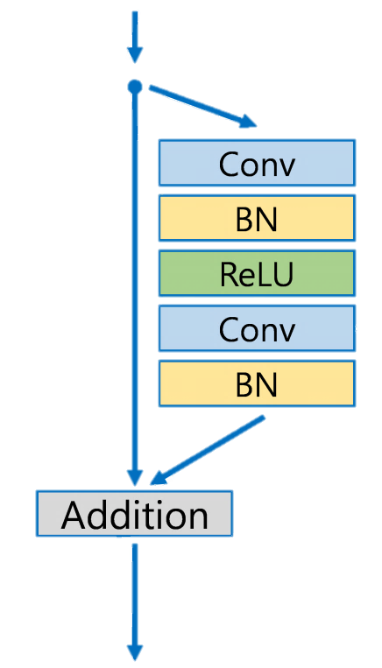


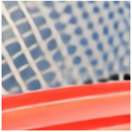

Visual Results
EDSR vs State of the Art
HR Ground Truth
Bicubic Upsample
SR ResNet
EDSR
Notes:
It is a comparison between the results of this network and the previous state of the art -> Here we have the original image -> And the High Resolution ground truth. And here -> the Bicubic upsampling, which is the actual best method in the field of simple interpolations. -> Here the results of latest State of the Art, the Super-Resolution ResNet. -> which used these blocks -> And here -> are the results the new proposed architecture. -> Using these new Blocks. As seen it is a high improvement on the results.

Slide 14
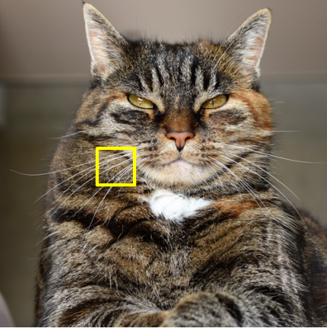
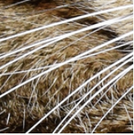

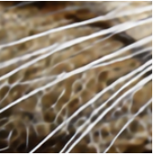
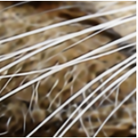
Visual Results
EDSR vs State of the Art
HR Ground Truth
Bicubic Upsample
SR ResNet
EDSR
Notes:
This is another comparison

Slide 15
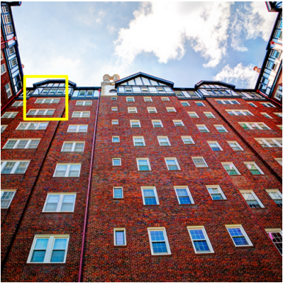
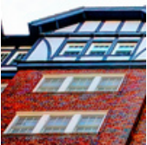

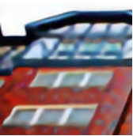

Visual Results
EDSR vs State of the Art
HR Ground Truth
Bicubic Upsample
SR ResNet
EDSR
Notes:
And this is another one.

Slide 16
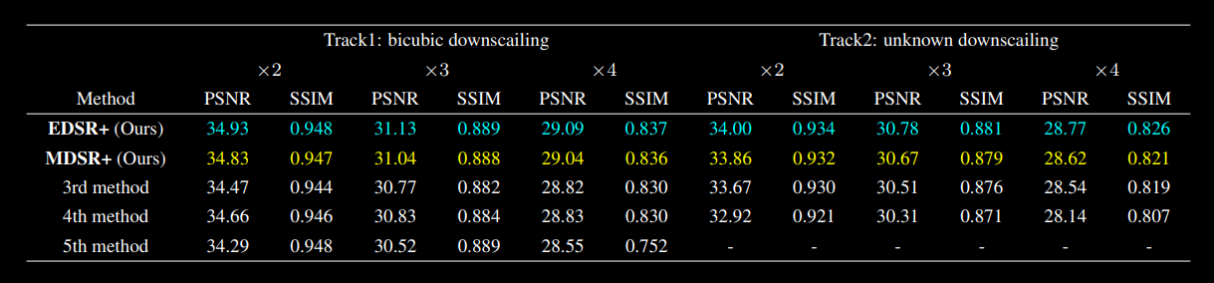
2017 Benchmark
EDSR vs State of the Art
NTIRE2017 Super-Resolution Challenge
1st and 2nd place in all categories
Notes:
Here is -> The table with the results that they obtained at the Twenty Seventeen Super-Resolution challenge. As seen, both methods proposed -> achieved the first and the second place in all tested categories. Both for bicubic down sampling as for unknown down sampling.

Slide 17
Future Research
Notes:
Finally, before ending, lets take a look in how the future of Super-Resolution evolved since this paper.

Slide 18
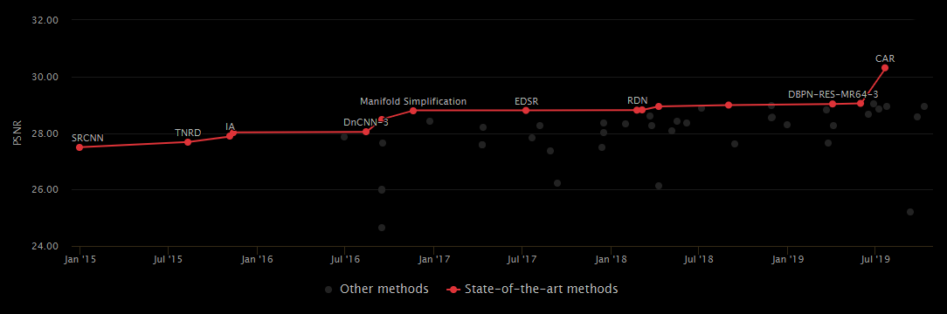
Opening roads
Evolution of the State of the Art 2017 - Today
EDSR Preceded by a Resampler Net
EDSR with Dense Skip Connections
ESDR
Notes:
This is the graphic of how the Super-Resolution field State of the art have evolved from Twenty Fifteen until Twenty Nineteen. -> Here is where this approach is ->. This next evolution is exactly the same network but adding Dense Skip connections between blocks. -> And this disruptive approach which made a high change in the field, is based on adding a Resampler Network just before this same network.

Slide 19
Conclusions
Notes:
So lets conclude

Slide 20



Conclusions
Redirecting the State of the Art
State of the Art in 2017 and high influence on the current State of the Art
Redefined the Residual Blocks used in Super-Resolution
Super-Resolution can have tons of applications
Notes:
Here, we have seen how -> The proposed network not only was the Twenty Seventeen State of the art in Super resolution, but also had a high influence on the evolution of the field. -> This high influence was due to the redefinition of the Residual Net blocks. And finally -> It is important to remark that super-resolution field is a research field that can allow tons of market applications, as for example, improving the mobile picture quality when they use a cheap hardware.

Slide 21
Thanks for your attendance
Notes:
Thanks for your attendance.

